Slide 1
Lesson 3: systems of linear equations
Introduction to Electronics - mathematics

Slide 2

Linear equations
1 equation with 1 unknown we solve by addition/subtraction/multiplication/division
  $$3x+8=−x−3$$
  $$4x=−11$$
  $$x=−\frac{11}{4}$$
If we have more equations with more unknowns, how do you tackle this?

Slide 3
















Two lines intersecting
If the equations of the lines are implicit, you quickly end up with fractions, with a high probability of calculation errors.
The safe way: elimination
$$2a−3b=4$$
$$∗5$$
$$2a−3b=4$$
$$∗3$$
$$3a+5b=25$$
$$∗3$$
$$3a+5b=25$$
$$∗(−2)$$
$$10a−15b=20$$
$$6a − 9b=12$$
$$9a+15b=75$$
$$−6a−10b=−50$$
$$19a =95$$
$$−19b=−38$$
$$a=5$$
$$b=2$$

Slide 4





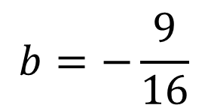








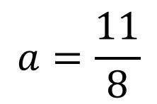

$$2a−4b=5$$
$$∗1$$
$$2a−4b=5$$
$$∗(−3)$$
$$3a+2b=3$$
$$∗2$$
$$3a+2b=3$$
$$∗2$$
$$2a−4b=5$$
$$−6a+12b=−15$$
$$6a+4b=6$$
$$6a + 4b=6$$
$$8a =11$$
$$16b=−9$$
$$a=\frac{11}{8}$$
$$b=−\frac{9}{16}$$

Slide 5
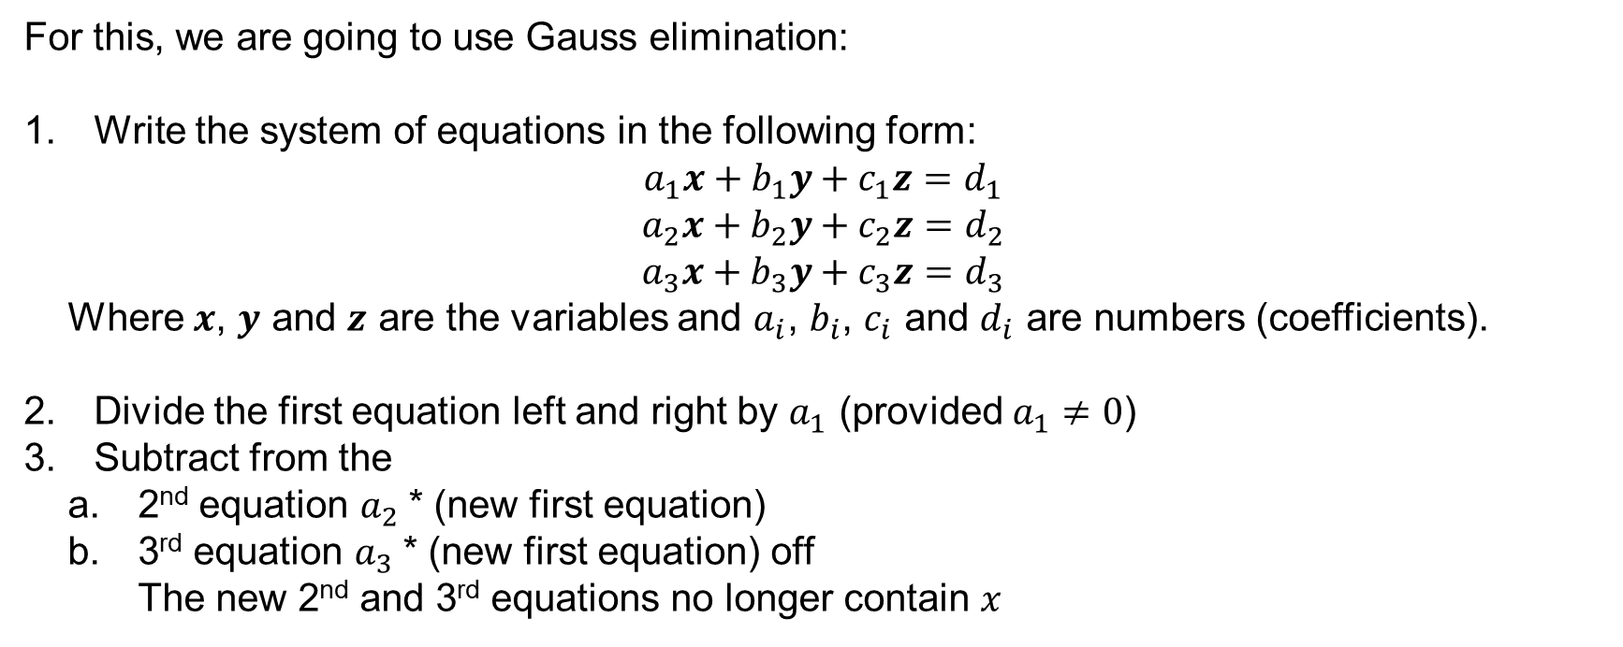
System of 3 equations with 3 variables
For this, we are going to use Gauss elimination:
Write the system of equations in the following form:
$$a_{1}x+b_{1}y+c_{1}z=d_{1}$$
$$a_{2}x+b_{2}y+c_{2}z=d_{2}$$
$$a_{3}x+b_{3}y+c_{3}z=d_{3}$$
  Where $x$, $y$ and $z$ are the variables and $a_{i}$, $b_{i}$, $c_{i}$ and $d_{i}$ are numbers (coefficients).
Divide the first equation left and right by $a_{1}$ (provided $a_{1}≠0$)
Subtract from the
  2nd equation $a_{2}$* (new first equation)
  3rd equation $a_{3}$* (new first equation) off
  The new 2nd and 3rd equations no longer contain $x$

Slide 6
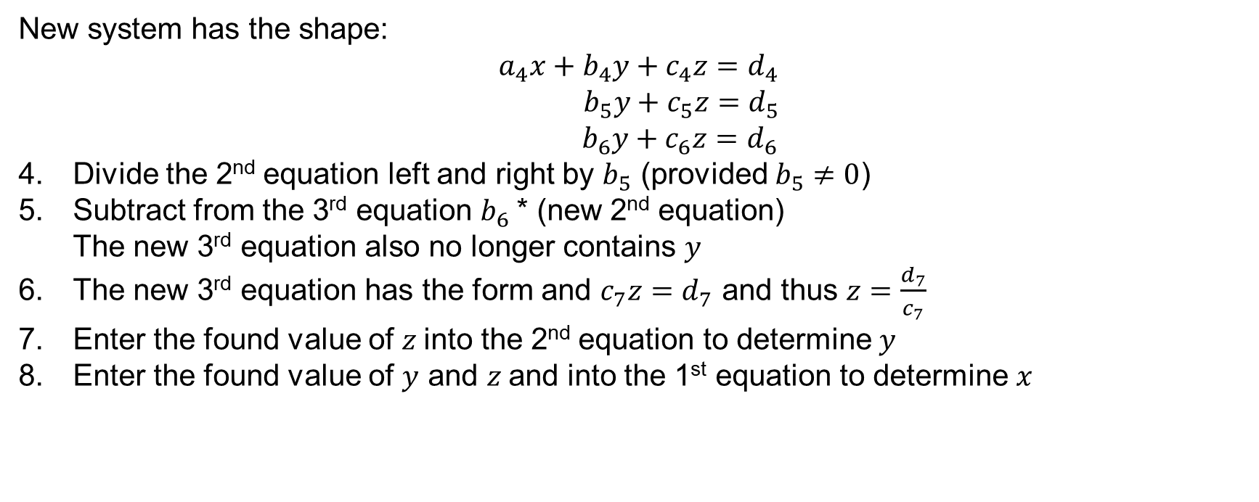
System of 3 equations with 3 unknowns
New system has the shape:
$$a_{4}x+b_{4}y+c_{4}z=d_{4}$$
$$b_{5}y+c_{5}z=d_{5}$$
$b_{6}y+c_{6}z=d_{6}$
Divide the 2nd equation left and right by $b_{5}$ (provided $b_{5}≠0$)
Subtract from the 3rd equation $b_{6}$* (new 2nd equation)
The new 3rd equation also no longer contains $y$
The new 3rd equation has the form and $c_{7}z=d_{7}$ and thus $z=\frac{d_{7}}{c_{7}}$
Enter the found value of $z$into the 2nd equation to determine $y$
Enter the found value of $y$ and $z$and into the 1st equation to determine $x$

Slide 7
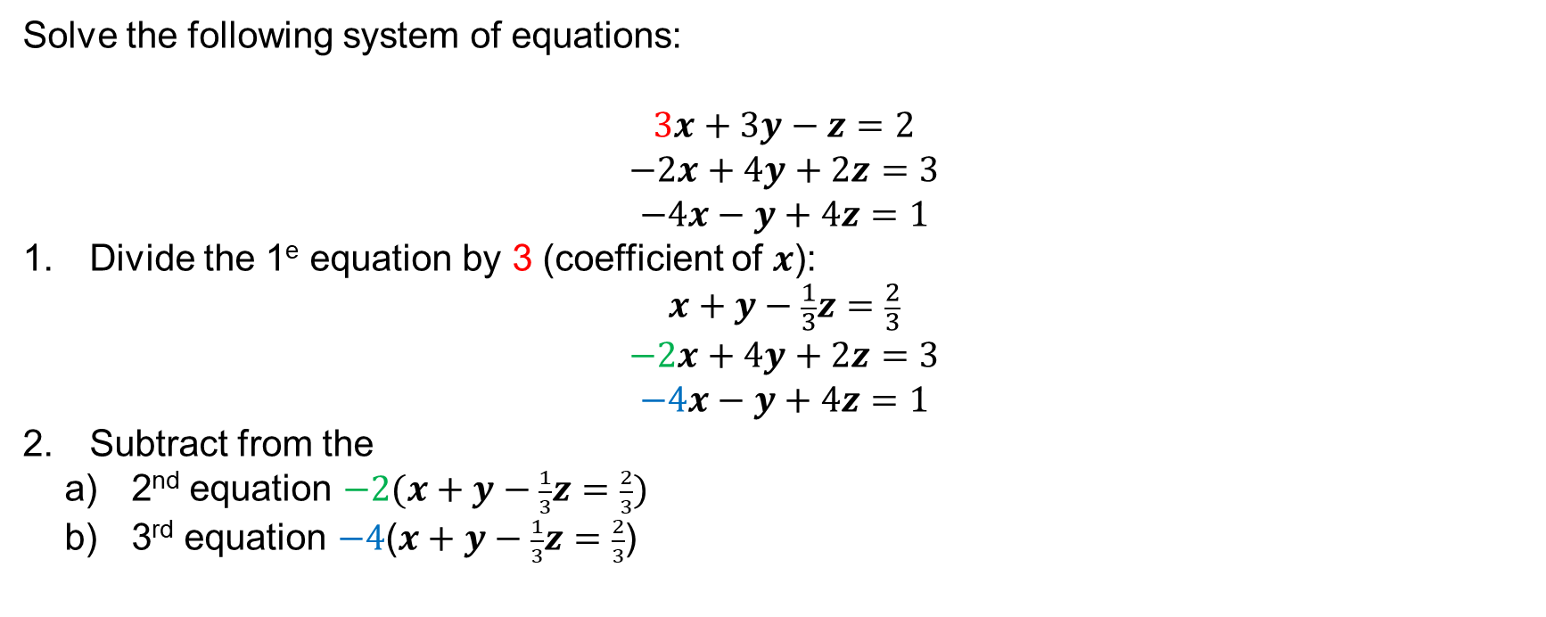
Example 1 Gauss elimination
Solve the following system of equations:
$$3x+3y−z=2$$
$$−2x+4y+2z=3$$
$$−4x−y+4z=1$$
Divide the 1e equation by 3 (coefficient of $x$):
$$x+y−\frac{1}{3}z=\frac{2}{3}$$
$$−2x+4y+2z=3$$
$$−4x−y+4z=1$$
Subtract from the
  2nd equation $−2(x+y−\frac{1}{3}z=\frac{2}{3})$
  3rd equation $−4$($x+y−\frac{1}{3}z=\frac{2}{3}$)

Slide 8
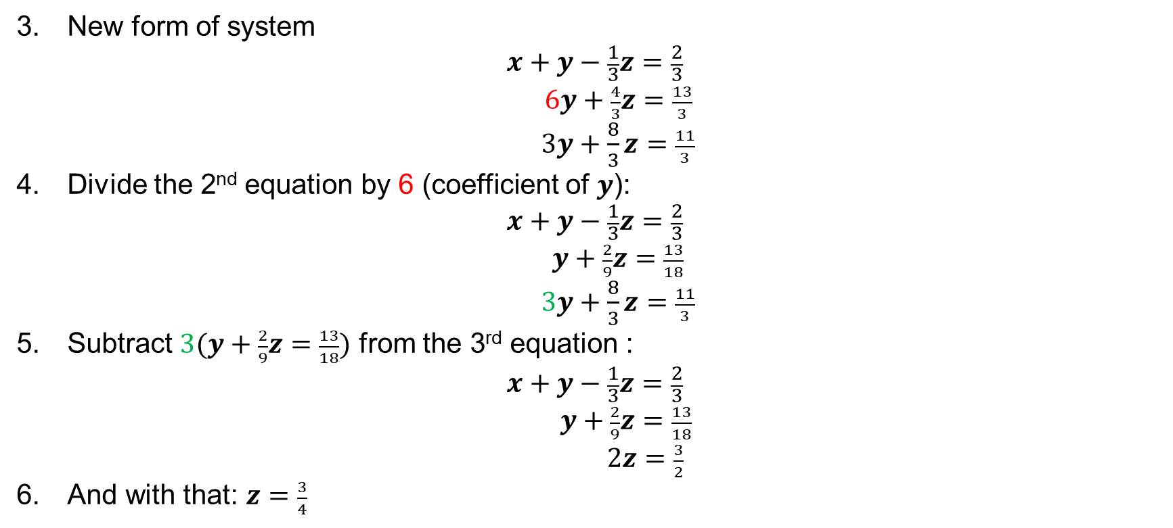
Example 1 Gauss elimination
New form of system
$$x+y−\frac{1}{3}z=\frac{2}{3}$$
$6y+\frac{4}{3}z=\frac{13}{3}$
$3y+\frac{8}{3}z=\frac{11}{3}$
Divide the 2nd equation by 6 (coefficient of $y$):
$$x+y−\frac{1}{3}z=\frac{2}{3}$$
$y+\frac{2}{9}z=\frac{13}{18}$
$3y+\frac{8}{3}z=\frac{11}{3}$
Subtract $3(y+\frac{2}{9}z=\frac{13}{18})$ from the 3rd equation :
$$x+y−\frac{1}{3}z=\frac{2}{3}$$
$y+\frac{2}{9}z=\frac{13}{18}$
$2z=\frac{3}{2}$
And with that: $z=\frac{3}{4}$

Slide 9
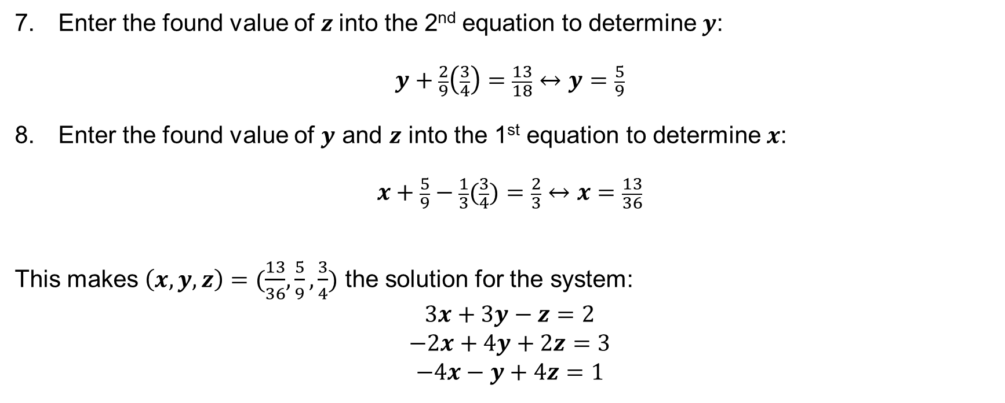
Example 1 Gauss elimination
Enter the found value of $z$into the 2nd equation to determine $y$:
$$y+\frac{2}{9}\left(\frac{3}{4}\right)=\frac{13}{18}↔y=\frac{5}{9}$$
Enter the found value of $y$ and $z$ into the 1st equation to determine $x$:
$$x+\frac{5}{9}−\frac{1}{3}(\frac{3}{4})=\frac{2}{3}↔x=\frac{13}{36}$$
This makes $\left(x,y,z\right)=(\frac{13}{36}, \frac{5}{9},\frac{3}{4})$ the solution for the system:
$$3x+3y−z=2$$
$$−2x+4y+2z=3$$
$$−4x−y+4z=1$$

Slide 10

Example 2
$$3x+4y+2z=6$$
$−x−3y+6z=3$
$$4x+6y+4z=8$$
Your move!

Slide 11
Need more explanation and practice?
Go to the course on Brightspace

